Slide 1
Adx and migrate to .net 6
Let’s Grow 1-2-2023

Slide 2
Content
Azure Data Explorer
Materialized views
Upgrade from .NET 4.8 to .NET 6

Slide 3
Materialized views
Materialized views expose an aggregation query over a source table, or over another materialized view.
Materialized views always return an up-to-date result of the aggregation query (always fresh). Querying a materialized view is more performant than running the aggregation directly over the source table.

Slide 4
Why use materialized views?
By investing resources (data storage, background CPU cycles) for materialized views of commonly used aggregations, you get the following benefits:
Performance improvement: Querying a materialized view commonly performs better than querying the source table for the same aggregation function(s).
Freshness: A materialized view query always returns the most up-to-date results, independent of when materialization last took place. The query combines the materialized part of the view with the records in the source table, which haven't yet been materialized (the delta part), always providing the most up-to-date results.
Cost reduction: Querying a materialized view consumes less resources from the cluster than doing the aggregation over the source table. Retention policy of source table can be reduced if only aggregation is required. This setup reduces hot cache costs for the source table.

Slide 5
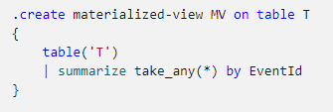
Materialized views use cases
The following are common scenarios that can be addressed by using a materialized view:
Update data by returning the last record per entity using arg_max() (aggregation function).
Reduce the resolution of data by calculating periodic statistics over the raw data. Use various aggregation functions by period of time.
For example, use T | summarize dcount(User) by bin(Timestamp, 1d) to maintain an up-to-date snapshot of distinct users per day.
Deduplicate records in a table using take_any() (aggregation function).
In deduplication scenarios, it might sometimes be useful to "hide" the source table with the materialized view, such that callers querying the table will query the deduplicated materialized view instead.
You can achieve this by creating a function with same name as the source table, that will reference the view instead of the source table. Since functions override tables with same name, users calling the "table" will actually query the materialized view.
When doing so, the materialized view definition must reference the source table using the table() function, to avoid cyclic references in the view definition:

Slide 6
How materialized views work
A materialized view is made of two components:
A materialized part - an Azure Data Explorer table holding aggregated records from the source table, which have already been processed. This table always holds a single record per the aggregation's group-by combination.
A delta - the newly ingested records in the source table that haven't yet been processed.
Querying the materialized view combines the materialized part with the delta part, providing an up-to-date result of the aggregation query. The offline materialization process ingests new records from the delta to the materialized table, and replaces existing records. The replacement is done by rebuilding extents that hold records to replace. If records in the delta constantly intersect with all data shards in the materialized part, each materialization cycle will require rebuilding the entire materialized part, and may not keep up with the ingestion rate. In that case, the view will become unhealthy and the delta will constantly grow. The materialized views monitoring page explains how to troubleshoot such situations.

Slide 7
Materialized views queries
There are 2 ways to query a materialized view:
Query the entire view: when you query the materialized view by its name, similarly to querying a table, the materialized view query combines the materialized part of the view with the records in the source table that haven't been materialized yet (the delta).
Querying the materialized view will always return the most up-to-date results, based on all records ingested to the source table. For more information about the materialized vs. non-materialized parts in materialized view, see how materialized views work.
This option might not perform best as it needs to materialize the delta part during query time. Performance in this case depends on the view's age and the filters applied in the query. The materialized view query optimizer section includes possible ways to improve query performance when querying the entire view.
Query the materialized part only: another way of querying the view is by using the materialized_view() function. This option supports querying only the materialized part of the view, while specifying the max latency the user is willing to tolerate.
This option isn't guaranteed to return the most up-to-date records, but it should always be more performant than querying the entire view.
This function is useful for scenarios in which you're willing to sacrifice some freshness for performance, for example for telemetry dashboards.

Slide 8
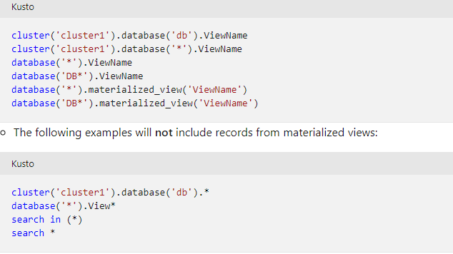
Materialized views queries
Materialized views participate in cross-cluster or cross-database queries, but aren't included in wildcard unions or searches.
The following examples will all include materialized views by the name ViewName:

Slide 9
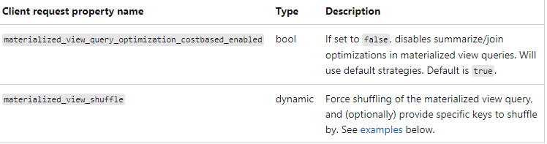
Materialized view query optimizer
When querying the entire view, the materialized part is combined with the delta during query time. This includes aggregating the delta and joining it with the materialized part.
Querying the entire view will perform better if the query includes filters on the group by keys of the materialized view query. See more tips about how to create your materialized view, based on your query pattern, in the .create materialized-view performance tips section.
Azure Data Explorer's query optimizer chooses summarize/join strategies that are expected to improve query performance. For example, the decision on whether to shuffle the query is based on number of records in delta part. The following client request properties provide some control over the optimizations applied. You can test these properties with your materialized view queries and evaluate their impact on queries performance.

Slide 10


Examples
Query the entire view. The most recent records in source table are included:
Query the materialized part of the view only, regardless of when it was last materialized.

Slide 11
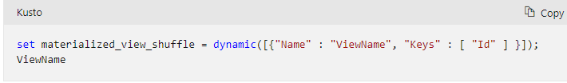

3. Query the entire view, and provide a "hint" to use shuffle strategy. The most recent records in source table are included:
Example #1: shuffle based on the Id column (similarly to using hint.shufflekey=Id):
Example #2: shuffle based on all keys (similarly to using hint.strategy=shuffle):

Slide 12
Performance considerations
Cluster resources: Like any other process running on the cluster, materialized views consume resources (CPU, memory) from the cluster. If the cluster is overloaded, adding materialized views to it may cause a degradation in the cluster's performance. Monitor your cluster's health using cluster health metrics. Optimized autoscale currently doesn't take materialized views health under consideration as part of autoscale rules.
Overlap with materialized data: During materialization, all new records ingested to the source table since the last materialization (the delta) are processed and materialized into the view. The higher the intersection between new records and already materialized records is, the worse the performance of the materialized view will be. A materialized view works best if the number of records being updated (for example, in arg_max view) is a small subset of the source table. If all or most of the materialized view records need to be updated in every materialization cycle, then the materialized view might not perform well.

Slide 13
Engine V3: Materialized views perform better on Engine V3 clusters, especially if the number of records to update in each iteration is high. If your cluster is not an Engine V3, you can create a support ticket to request migration.
Ingestion rate: There are no hard-coded limits on the data volume or ingestion rate in the source table of the materialized view. However, the recommended ingestion rate for materialized views is no more than 1-2GB/sec. Higher ingestion rates may still perform well. Performance depends on cluster size, available resources, and amount of intersection with existing data.
Number of materialized views in cluster: The above considerations apply to each individual materialized view defined in the cluster. Each view consumes its own resources, and many views will compete with each other on available resources. While there are no hard-coded limits to the number of materialized views in a cluster, the cluster may not be able to handle all materialized views, when there are many defined. The capacity policy can be adjusted if there is more than a single materialized view in the cluster. Increase the value of ClusterMinimumConcurrentOperations in the policy to run more materialized views concurrently.
Materialized view definition: The materialized view definition must be defined according to query best practices for best query performance. For more information, see create command performance tips.

Slide 14
Commands
https://learn.microsoft.com/en-us/azure/data-explorer/kusto/management/materialized-views/materialized-view-create
https://learn.microsoft.com/en-us/azure/data-explorer/kusto/management/materialized-views/materialized-view-alter
https://learn.microsoft.com/en-us/azure/data-explorer/kusto/management/materialized-views/materialized-view-show-commands

Slide 15
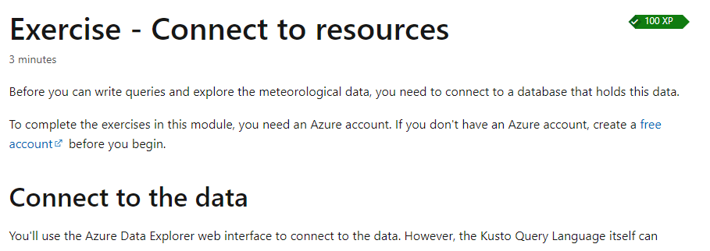
Exercise: materialized views
https://learn.microsoft.com/en-us/training/modules/gain-insights-data-kusto-query-language/3-exercise-connect-to-resources

Slide 16
Create a Materialized view
Recall that in the storm events, you've used aggregation functions to compare different groups of information. You've organized complex queries with let statements. Finally, you've presented this data in graphical format.
Now it's your turn to try writing a query from scratch.
Use the table we've been exploring up until now, StormEvents, to answer the following question:
What was the total week-by-week damage caused by all flood events? Show damage in the unit of Euros. In this case, damage refers to both property and crop damage. Assume the Euro is worth 1.14 USD.
Use summarize, sum, render, bin, and let.

Slide 17
Migrating from .net Framework 4.8
.NET 6 and .NET 7 was formerly named .NET Core
Porting to .NET from .NET Framework for many projects is relatively straightforward. The complexity of your projects dictates how much work you'll do after the initial migration of the project files.
Projects where the app model is available in .NET, such as libraries, console apps, and desktop apps, usually require little change. Projects that require a new app model, such as moving to ASP.NET Core from ASP.NET, require more work. Many patterns from the old app model have equivalents that can be used during the conversion.

Slide 18
Windows desktop technologies
Many applications created for .NET Framework use a desktop technology such as Windows Forms or Windows Presentation Foundation (WPF). Both Windows Forms and WPF have been ported to .NET, but these remain Windows-only technologies.
Consider the following dependencies before you migrate a Windows Forms or WPF application:
Project files for .NET use a different format than .NET Framework.
Your project might use an API that isn't available in .NET.
Third-party controls and libraries might not have been ported to .NET and remain only available to .NET Framework.
Your project uses a technology that is no longer available in .NET.
.NET uses the open-source versions of Windows Forms and WPF and includes enhancements over .NET Framework.
Notes:
https://learn.microsoft.com/en-us/dotnet/desktop/wpf/migration/convert-project-from-net-framework?view=netdesktop-6.0&preserve-view=true
https://learn.microsoft.com/en-us/dotnet/desktop/winforms/migration/?view=netdesktop-6.0&preserve-view=true

Slide 19
Windows-specific APIs
Applications can still P/Invoke native libraries on platforms supported by .NET. This technology isn't limited to Windows. However, if the library you're referencing is Windows-specific, such as a user32.dll or kernel32.dll, then the code only works on Windows. For each platform you want your app to run on, you'll have to either find platform-specific versions, or make your code generic enough to run on all platforms.
When you're porting an application from .NET Framework to .NET, your application probably used a library provided by .NET Framework. Many APIs that were available in .NET Framework weren't ported to .NET because they relied on Windows-specific technology, such as the Windows Registry or the GDI+ drawing model.
The Windows Compatibility Pack provides a large portion of the .NET Framework API surface to .NET and is provided via the Microsoft.Windows.Compatibility NuGet package
Notes:
https://learn.microsoft.com/en-us/dotnet/core/porting/windows-compat-pack

Slide 20
Analyze your dependencies to port code from .NET Framework to .NET
To identify the unsupported third-party dependencies in your project, you must first understand your dependencies. External dependencies are the NuGet packages or .dll files you reference in your project, but that you don't build yourself.
Porting your code to .NET Standard 2.0 or below ensures that it can be used with both .NET Framework and .NET. However, if you don't need to use the library with .NET Framework, consider targeting the latest version of .NET.

Slide 21
Migrate your NuGet packages to PackageReference
.NET can't use the packages.config file for NuGet references. Both .NET and .NET Framework can use PackageReference to specify package dependencies. If you're using packages.config to specify your packages in your project, convert it to the PackageReference format.
Notes:
https://learn.microsoft.com/en-us/nuget/consume-packages/migrate-packages-config-to-package-reference

Slide 22
Upgrade your NuGet packages
After you migrate your project to the PackageReference format, verify if your packages are compatible with .NET.
First, upgrade your packages to the latest version that you can. This can be done with the NuGet Package Manager UI in Visual Studio. It's likely that newer versions of your package dependencies are already compatible with .NET Core.

Slide 23
Analyze your package dependencies
If you haven't already verified that your converted and upgraded package dependencies work on .NET Core, there are a few ways that you can achieve that:
Analyze NuGet packages using nuget.org
You can see the Target Framework Monikers (TFMs) that each package supports on nuget.org under the Dependencies section of the package page.
Although using the site is an easier method to verify the compatibility, Dependencies information isn't available on the site for all packages.

Slide 24
Analyze NuGet packages using NuGet Package Explorer
A NuGet package is itself a set of folders that contain platform-specific assemblies. Check if there's a folder that contains a compatible assembly inside the package.
The easiest way to inspect NuGet package folders is to use the NuGet Package Explorer tool. After installing it, use the following steps to see the folder names:
Open the NuGet Package Explorer.
Click Open package from online feed.
Search for the name of the package.
Select the package name from the search results and click open.
Expand the lib folder on the right-hand side and look at folder names.
Look for a folder with names using one the following patterns: netstandardX.Y, netX.Y, or netcoreappX.Y.
These values are the Target Framework Monikers (TFMs) that map to versions of .NET Standard, .NET, and .NET Core, which are all compatible with .NET.

Slide 25
.NET Framework compatibility mode
After analyzing the NuGet packages, you might find that they only target the .NET Framework.
Starting with .NET Standard 2.0, the .NET Framework compatibility mode was introduced. This compatibility mode allows .NET Standard and .NET Core projects to reference .NET Framework libraries. Referencing .NET Framework libraries doesn't work for all projects, such as if the library uses Windows Presentation Foundation (WPF) APIs, but it does unblock many porting scenarios.
When you reference NuGet packages that target .NET Framework in your project, such as Huitian.PowerCollections, you get a package fallback warning (NU1701) similar to the following example:
NU1701: Package ‘Huitian.PowerCollections 1.0.0’ was restored using ‘.NETFramework,Version=v4.6.1’ instead of the project target framework ‘.NETStandard,Version=v2.0’. This package may not be fully compatible with your project.

Slide 26
.NET Framework compatibility mode
That warning is displayed when you add the package and every time you build to make sure you test that package with your project. If your project works as expected, you can suppress that warning by editing the package properties in Visual Studio or by manually editing the project file in your favorite code editor.
To suppress the warning by editing the project file, find the PackageReference entry for the package you want to suppress the warning for and add the NoWarn attribute. The NoWarn attribute accepts a comma-separated list of all the warning IDs. The following example shows how to suppress the NU1701 warning for the Huitian.PowerCollections package by editing your project file manually:

Slide 27
If NuGet packages won't run on .NET
There are a few things you can do if a NuGet package you depend on doesn't run on .NET Core:
If the project is open source and hosted somewhere like GitHub, you can engage the developers directly.
You can contact the author directly on nuget.org. Search for the package and click Contact Owners on the left-hand side of the package's page.
You can search for another package that runs on .NET Core that accomplishes the same task as the package you were using.
You can attempt to write the code the package was doing yourself.
You could eliminate the dependency on the package by changing the functionality of your app, at least until a compatible version of the package becomes available.
Remember that open-source project maintainers and NuGet package publishers are often volunteers. They contribute because they care about a given domain, do it for free, and often have a different daytime job. Be mindful of that when contacting them to ask for .NET Core support.

Slide 28
Unavailable technologies
There are a few technologies in .NET Framework that don't exist in .NET:
Application domains
Creating additional application domains isn't supported. For code isolation, use separate processes or containers as an alternative.
Remoting
Remoting is used for communicating across application domains, which are no longer supported. For simple communication across processes, consider inter-process communication (IPC) mechanisms as an alternative to remoting, such as the System.IO.Pipes class or the MemoryMappedFile class. For more complex scenarios, consider frameworks such as StreamJsonRpc or ASP.NET Core (either using gRPC or RESTful Web API services).

Slide 29
Code access security (CAS)
AS was a sandboxing technique supported by .NET Framework but deprecated in .NET Framework 4.0. It was replaced by Security Transparency and it isn't supported in .NET. Instead, use security boundaries provided by the operating system, such as virtualization, containers, or user accounts.
Security transparency
Similar to CAS, the security transparency sandboxing technique is no longer recommended for .NET Framework applications and it isn't supported in .NET. Instead, use security boundaries provided by the operating system, such as virtualization, containers, or user accounts.
System.EnterpriseServices
System.EnterpriseServices (COM+) isn't supported in .NET.
Windows Workflow Foundation (WF)
WF isn't supported in .NET. For an alternative, see CoreWF

Slide 30
Cross-platform
.NET (formerly known as .NET Core) is designed to be cross-platform. If your code doesn't depend on Windows-specific technologies, it can run on other platforms such as macOS, Linux, and Android. Such code includes project types like:
Libraries
Console-based tools
Automation
ASP.NET sites
.NET Framework is a Windows-only component. When your code uses Windows-specific technologies or APIs, such as Windows Forms and WPF, the code can still run on .NET but it won't run on other operating systems.
It's possible that your library or console-based application can be used cross-platform without changing much. When you're porting to .NET, you might want to take this into consideration and test your application on other platforms.

Slide 31
Tools to assist porting
Instead of manually porting an application from .NET Framework to .NET, you can use different tools to help automate some aspects of the migration. Porting a complex project is, in itself, a complex process. The tools might help in that journey.

Slide 32
.NET Upgrade Assistant
The .NET Upgrade Assistant is a command-line tool that can be run on different kinds of .NET Framework apps. It's designed to assist with upgrading .NET Framework apps to .NET. After running the tool, in most cases the app will require more effort to complete the migration. The tool includes the installation of analyzers that can assist with completing the migration. This tool works on the following types of .NET Framework applications:
Windows Forms
WPF
ASP.NET MVC
Console
Class libraries
Notes:
https://learn.microsoft.com/en-us/dotnet/core/porting/
https://learn.microsoft.com/en-us/dotnet/core/porting/upgrade-assistant-overview

Slide 33
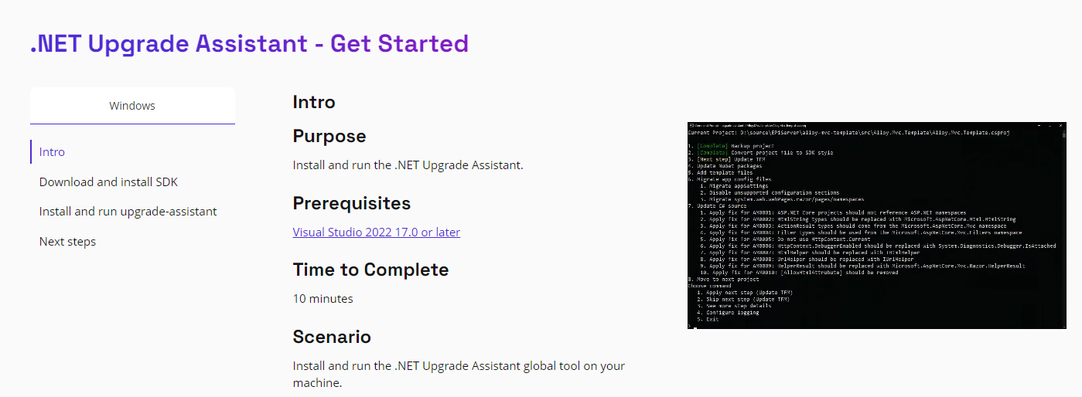
Install the upgrade assistant
https://dotnet.microsoft.com/en-us/platform/upgrade-assistant/tutorial/intro

Slide 34
Exercise: Check .NET 4.8 MVS ASP.NET APP
Create a .NET 4.8 ASP.NET MVC Application and use it to test the Upgrade Assistant
Create a WPF app and do the same

Slide 35
try-convert
The try-convert tool is a .NET global tool that can convert a project or entire solution to the .NET SDK, including moving desktop apps to .NET. However, this tool isn't recommended if your project has a complicated build process such as custom tasks, targets, or imports.
Notes:
https://github.com/dotnet/try-convert

Slide 36
.NET Portability Analyzer
The .NET Portability Analyzer is a tool that analyzes assemblies and provides a detailed portability report. It reports .NET APIs that are missing in the applications or libraries to be ported on your specified targeted .NET platforms.
To use the .NET Portability Analyzer in Visual Studio, install the extension from the marketplace
Notes:
https://marketplace.visualstudio.com/items?itemName=ConnieYau.NETPortabilityAnalyzer
https://learn.microsoft.com/en-us/dotnet/standard/analyzers/portability-analyzer

Slide 37
Platform compatibility analyzer
The Platform compatibility analyzer analyzes whether or not you're using an API that will throw a PlatformNotSupportedException at run time. Although finding one of these APIs is unlikely if you're moving from .NET Framework 4.7.2 or higher, it's good to check. For more information about APIs that throw exceptions on .NET, see APIs that always throw exceptions on .NET Core.
Notes:
https://learn.microsoft.com/en-us/dotnet/standard/analyzers/platform-compat-analyzer

Slide 38
ASP.NET Porting guide
https://dotnet.microsoft.com/en-us/download/e-book/porting-aspnet-apps/pdf

Slide 39
Considerations when porting
When porting your application to .NET, consider the following suggestions in order:
✔️ CONSIDER using the .NET Upgrade Assistant to migrate your projects. Even though this tool is in preview, it automates most of the manual steps detailed in this article and gives you a great starting point for continuing your migration path.
✔️ CONSIDER examining your dependencies first. Your dependencies must target .NET, .NET Standard, or .NET Core.
✔️ DO migrate from a NuGet packages.config file to PackageReference settings in the project file. Use Visual Studio to convert the package.config file.
✔️ CONSIDER upgrading to the latest project file format even if you can't yet port your app. .NET Framework projects use an outdated project format. Even though the latest project format, known as SDK-style projects, was created for .NET Core and beyond, they work with .NET Framework. Having your project file in the latest format gives you a good basis for porting your app in the future.

Slide 40
Considerations when porting
✔️ DO retarget your .NET Framework project to at least .NET Framework 4.7.2. This ensures the availability of the latest API alternatives for cases where .NET Standard doesn't support existing APIs.
✔️ CONSIDER targeting .NET 6, which is a long-term support (LTS) release.
✔️ DO target .NET 6+ for Windows Forms and WPF projects. .NET 6 contains many improvements for Desktop apps.
✔️ CONSIDER targeting .NET Standard 2.0 if you're migrating a library that might also be used with .NET Framework projects. You can also multitarget your library, targeting both .NET Framework and .NET Standard.
✔️ DO add reference to the Microsoft.Windows.Compatibility NuGet package if, after migrating, you get errors of missing APIs. A large portion of the .NET Framework API surface is available to .NET via the NuGet package.

